Slide 1


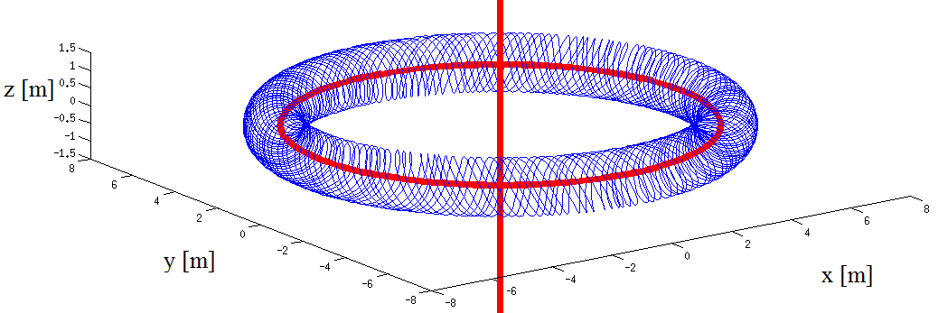
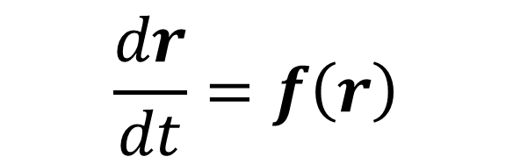
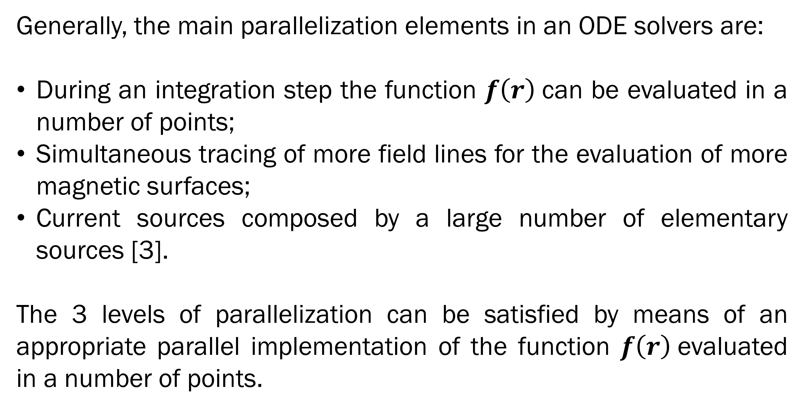
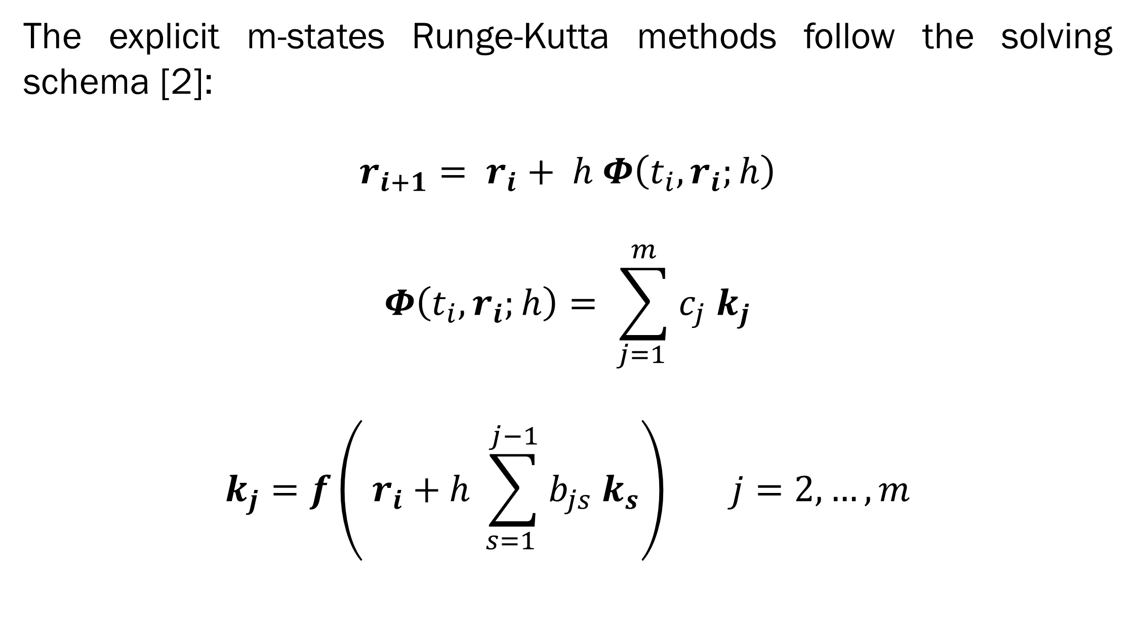
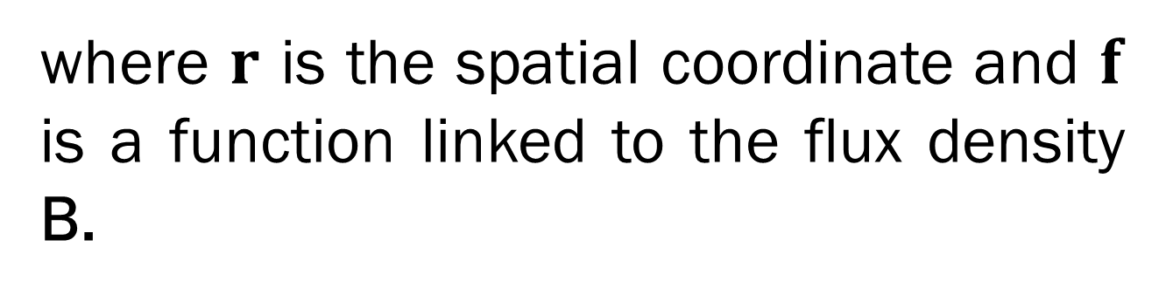
Magnetic Field Line Tracing Inside a Plasma by Means of GPU Numerical Integration
A. G. Chiariello, A. Formisano, F. Ledda, R. Martone, F. Pizzo
Department of IIndustrial e Information Engineering, Seconda Università degli Studi di Napoli, Via Roma 29, Aversa (CE)
e-mail: francesco.ledda@unina2.it)
Abstract
A critical problem in the study of controlled thermonuclear fusion devices (tokamak) is the identification of the magnetic surfaces of the plasma.
In large tokamaks (ITER, DEMO), where the axisymmetric hypothesis can be not satisfied, the 3D magnetic surfaces can be obtained starting from the tracing of the magnetic field lines.
The tracing of field lines can be quite a demanding problem. High-performance computing architectures can be useful to lower the execution times, especially in presence of complex sources.
Aim of the Work
Example of application
In the tracing of magnetic field lines the resolution of an Ordinary Differential Equation (ODE) has to be done. The function to be integrated is strictly related to the flux density B.
The work proposes a parallel GPU implementation of the explicit ODE solving schema Runge-Kutta of the 4th-5th order. The improvements in terms of execution time for a typical line tracing application are evaluated.
In this example, the sources considered are a circular current of 10 MA and a straight current line (Fig. 1) of 27.1 MA discretized with different numbers of current segments [4].
Tab. 1 show the execution time for 100 Runge-Kutta 4-5 integration steps on a classical i7 CPU core implementation and the speed-up achieved by the GPU Tesla C2075 implementation.
Mathematical Formulation
In Cartesian coordinates, the problem of the field lines tracing can be expressed as
$$\frac{dr}{dt}=f\left(r\right)$$
where $r$ is the spatial coordinate and $f$ is a function linked to the flux density B.
The explicit m-states Runge-Kutta methods follow the solving schema [2]:
$$r_{i+1}= r_{i}+ h Φ\left(t_{i}, r_{i};h\right)$$
$$Φ\left(t_{i}, r_{i};h\right)= \sum_{j=1 }^{m}{c_{j} k_{j}}$$
$$k_{j}=f\left( r_{i}+h \sum_{s=1 }^{j−1}{b_{js} k_{s}}\right) j=2, …, m$$
Fig. 1: Example of field line in a tokamak
 | 10⁵ segments |  | 10⁶ segments
# of lines | CPU [s] | Speed-up | CPU [s] | Speed-up
1 | 1.74 | 3.78 | 1.74 x 10 | 20.24
10 | 1.73 x 10 | 19.49 | 1.76 x 10² | 29.88
100 | 1.73 x 10² | 28.15 | 1.74 x 10³ | 34.07
GPU implementation
Tab 1: Execution time on 100 steps of integration
Generally, the main parallelization elements in an ODE solvers are:
During an integration step the function $f\left(r\right)$can be evaluated in a number of points;
Simultaneous tracing of more field lines for the evaluation of more magnetic surfaces;
Current sources composed by a large number of elementary sources [3].
The 3 levels of parallelization can be satisfied by means of an appropriate parallel implementation of the function $f\left(r\right)$evaluated in a number of points.
References
[1] J. Dormand, P. J. Prince. "A family of embedded Runge-Kutta formulae", Journal of Computational and Applied Mathematics, Vol. 6, pp 19-26, March 1980.
[2] V. Comincioli, Analisi numerica: metodi, modelli, applicazioni, Apogeo, 2010.
[3] A. G. Chiariello, A. Formisano, and R. Martone, “Fast magnetic field computation in fusion technology using GPU technology”, Fusion Eng. Des., vol. 88, no. 9-10, pp. 1635-1639, Oct. 2013.
[4] J. D. Hanson, S. P. Hirshman, “Compact expressions for the Biot–Savart fields of a filamentary segment”, Phys. Plasmas, vol. 9, no. 10, pp. 4410-4412, 2002.

